Slide 1



The Network Matters
TM
Open everywhere
Kivi Open networking presentatie
Bernard Schep, Regional Sales Manager - Northern Europe
May 2021

Slide 2
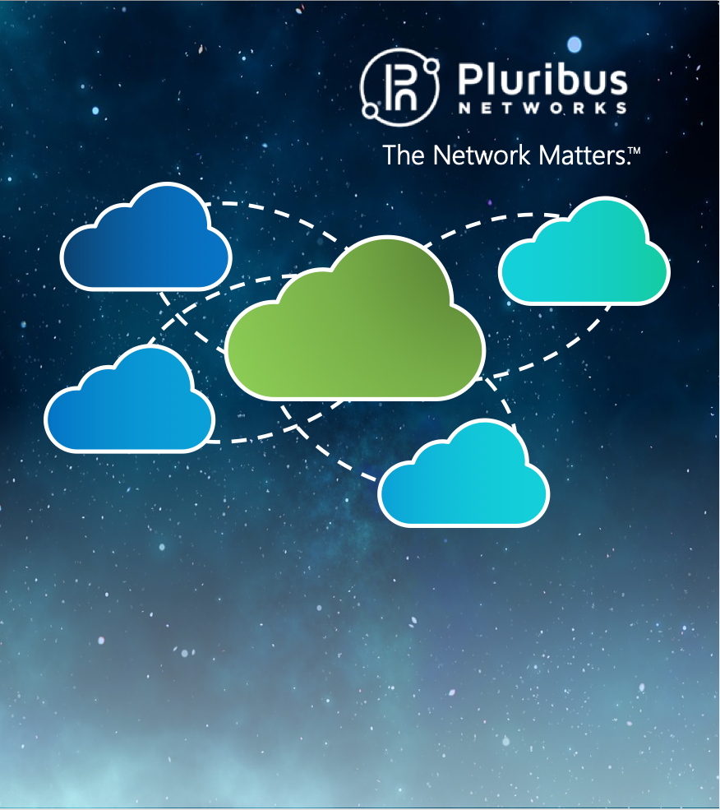
Agenda
Historie
Hardware spelers
Software spelers
Links & overige info

Slide 3

Open Compute Project - OCP
2009 Facebook ontwerpt nieuwe datacenter architectuur
2011 oprichting OCP door FB met Intel, Rackspace, Goldman Sachs en Andi Bechtolsheim en publiseert design
2013, Open Network Install Environment (ONIE) adopted
2021 compleet open datacenter design (power, rack, networking, compute, storage)

Slide 4
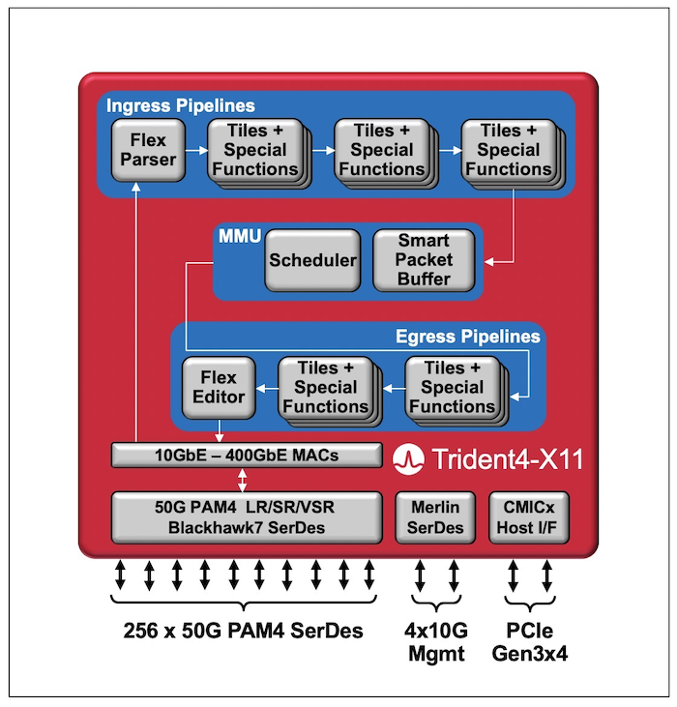

Chipsets / Network Processors
Broadcom
Trident
Tomahawk
Maverick
Jericho
Fiberchannel

Slide 5
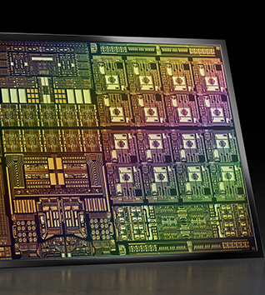
NVIDIA (Mellanox)
NVIDIA BlueField-3 DPU
  NVIDIA BlueField-3 is the first 400Gb/s / NDR DPU with line-rate processing of software- defined networking, storage, and cybersecurity.
Infiniband

Slide 6

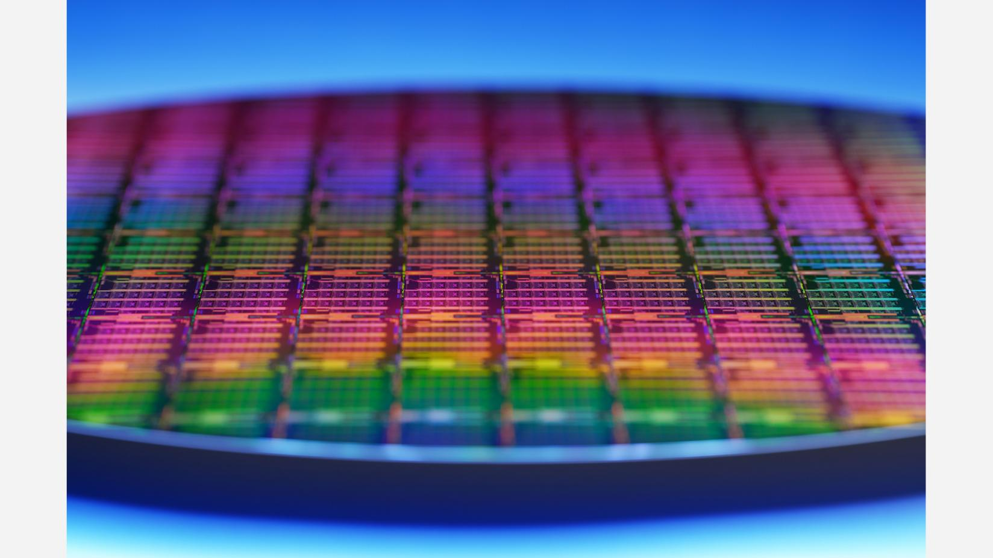
Intel
Time Sync NIC
  Ethernet 800 Series card (aka Columbiaville NIC ) – PTP, SynE, 3 MuSec
vRAN FEC Accelerator ACC100
3rd Generation Intel Xeon Scalable Processor Ice Lake – real time RAN functions DU, CU, baseband

Slide 7

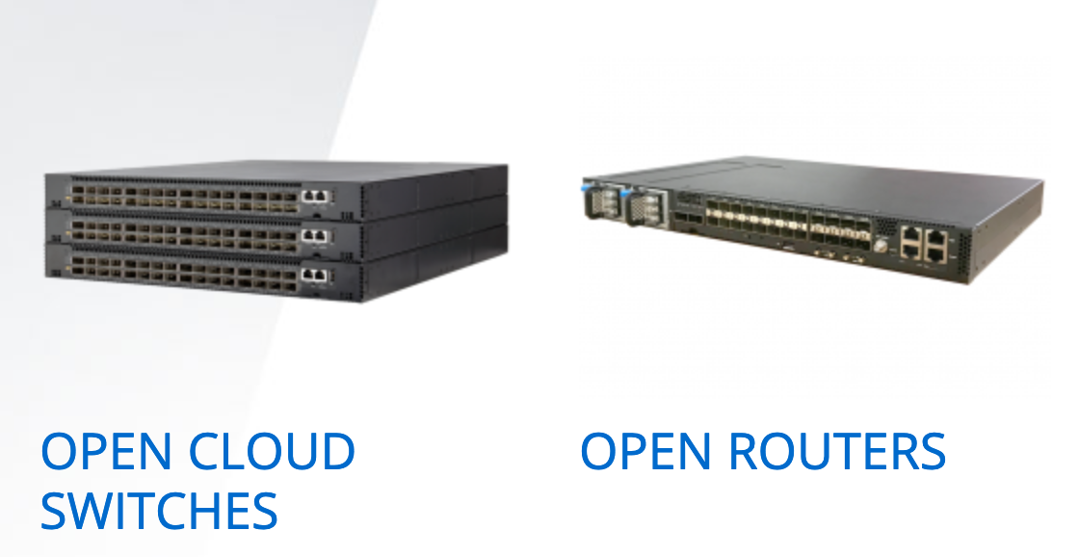
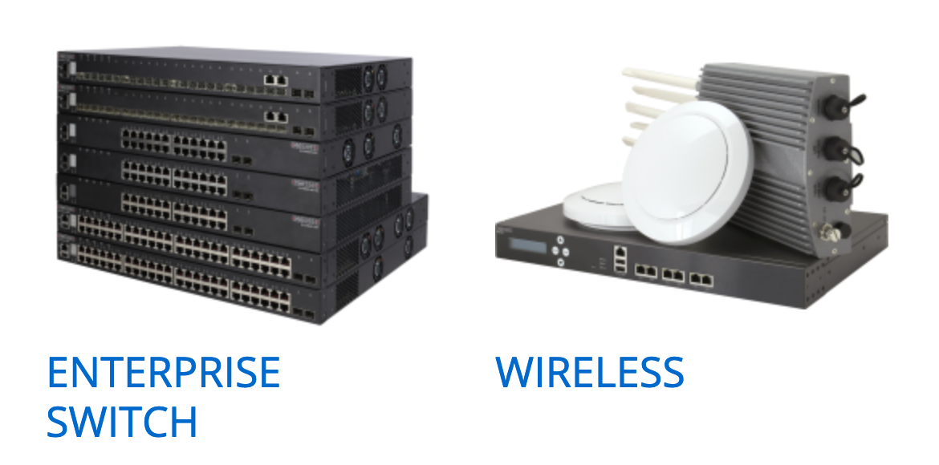
Hardware spelers
Onderdeel van Accton, Taiwan
Open Cloud Switches 400G AS9716-32D
400 GbE Data Center Switch Bare-Metal Hardware
  The Edgecore AS9716-32D is a spine switch for high-performance data centers. The switch provides line-rate L2 and L3 switching across the 32 x QSFP56-DD ports, each supporting 1 x 400 GbE or 1 x 100 GbE, or via breakout cables 4 x 100 GbE or 4 x 25 GbE.

Slide 8

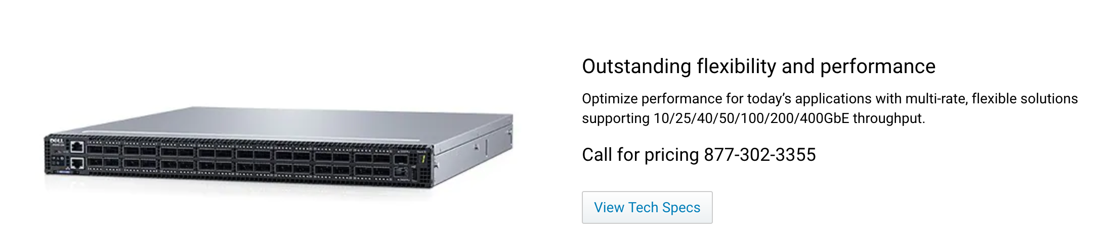
Dell Technologies (Force10)
Dell EMC PowerSwitch Data Center Switches
- OS10, Sonic, Pluribus

Slide 9
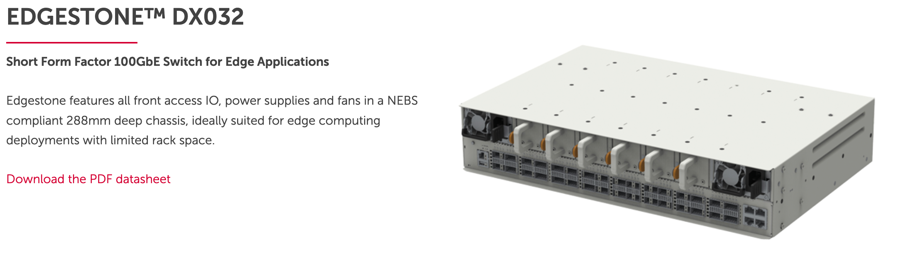
Celestica
Hardware Platform Solutions
Networking
  NEBS compliant
  Carrier grade
Storage
Compute

Slide 10

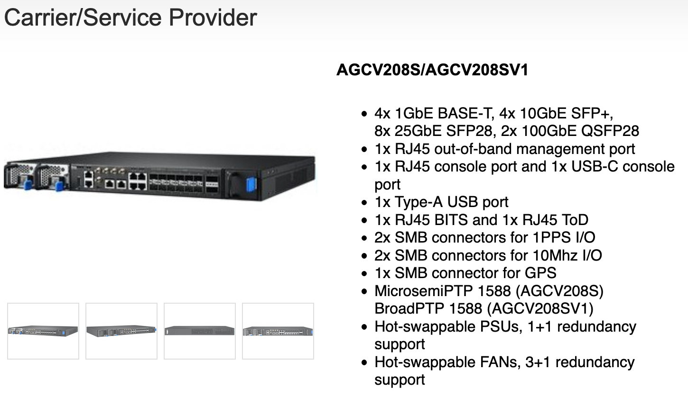
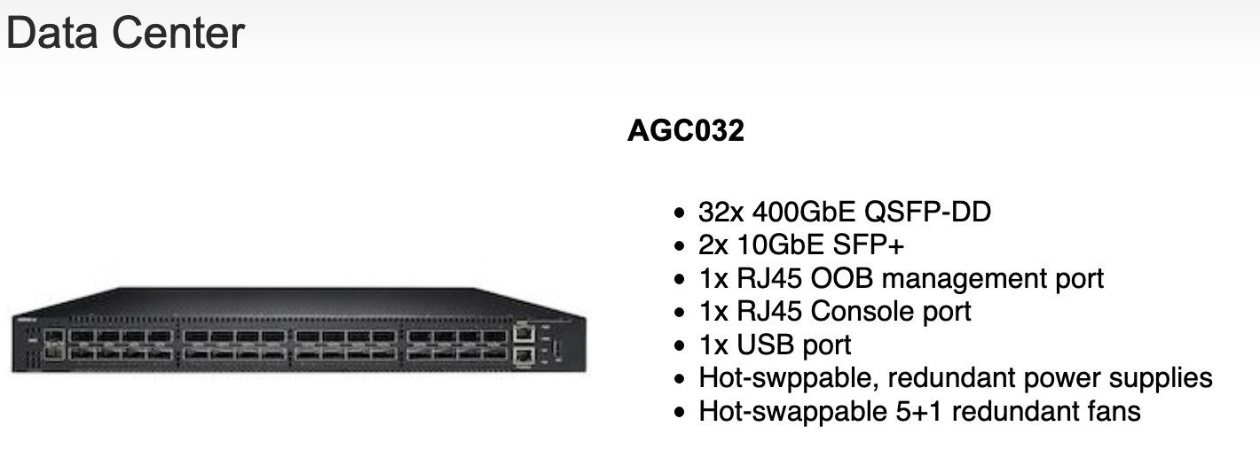
Delta

Slide 11
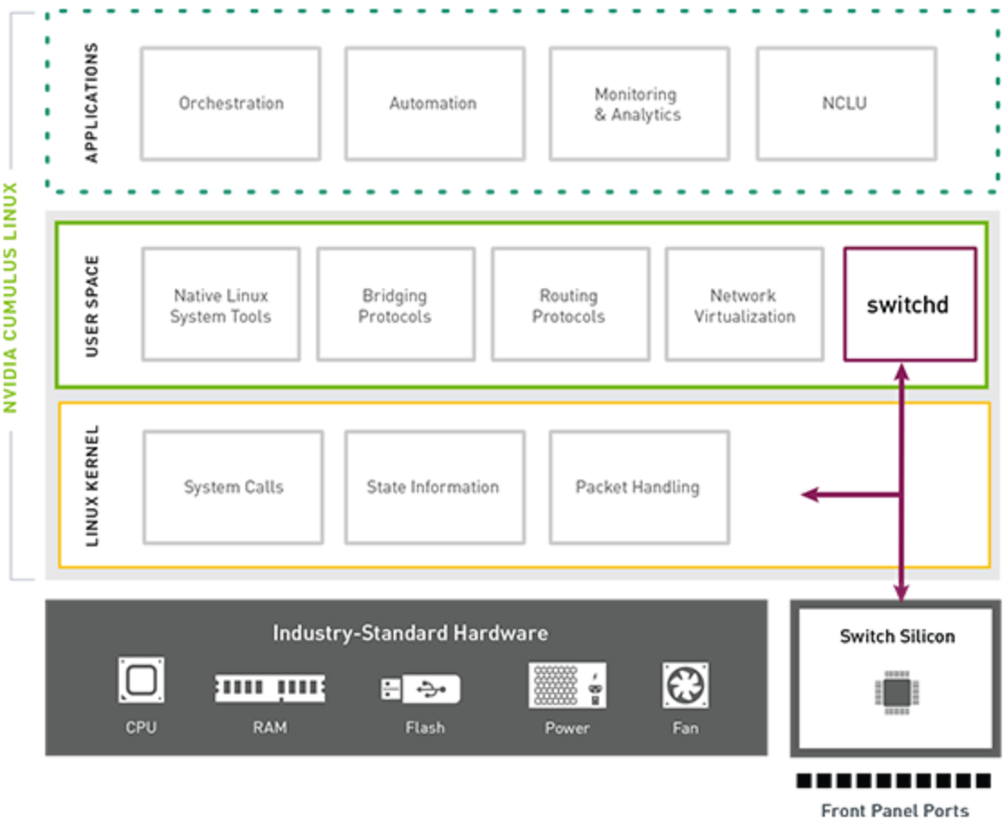
Open Network Operating Software
NVIDIA Cumulus Linux
Networking zoals Linux
ONIE
Marktleider in Open NOS
Toegang tot Broadcom afgesloten
Toekomst zorgelijk

Slide 12

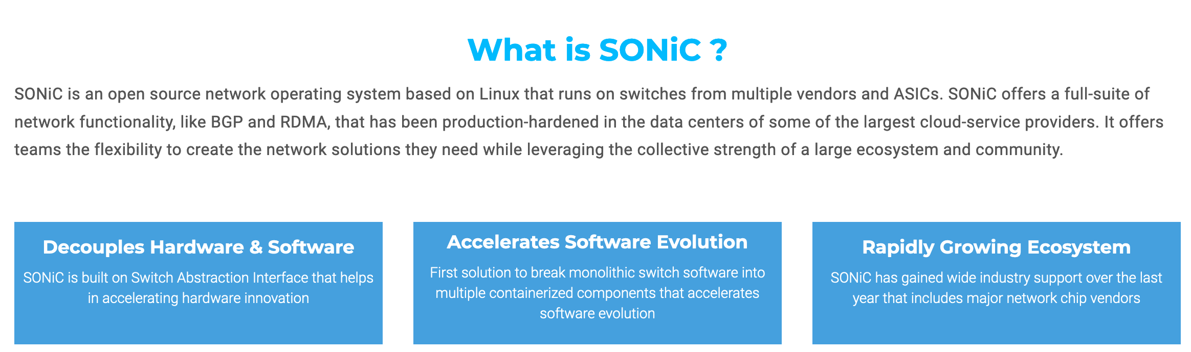
Sonic
OCP project, backed by Microsoft
Azure underlay
Groot netwerk van partners/deelnemers
Open Source

Slide 13
Dell Technologies OS10 Enterprise Edition
Entry level DC NOS
Limited functionality (moderne DC protocols beperkt ondersteund)
Kosten effectief, concurerend

Slide 14
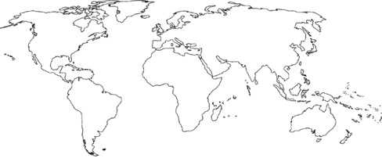











Pluribus Networks
Industry Leader in Open Networking & Next Generation SDN
Deep Technical Expertise
Global Strength
Strategic Partnerships
Sales
Support
Development & Global Support
Founded in 2010 by Stanford University Engineers with deep background in server virtualization, distributed systems, networking & clustering.
25 patents filed; 22 issued; 3 pending
Silicon Valley HQ & Global Support
Sales
Support
Global 24x7 Support
Average TAC experience >15 yrs.
300+ Global Customers | 75+ Tier 1 Mobile Operators | Cloud & Managed SPs | Enterprise

Slide 15
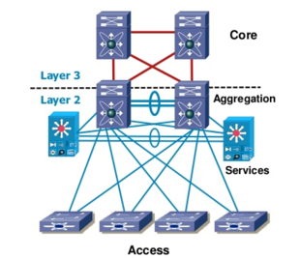



The Better Way to Build Data Center Fabrics
Legacy Approach
Controller-based SDN Fabric
Controllerless SDN Fabric
Unified Management
Automation & Analytics
CONTROLLER
OOB
CONTROLLER
CONTROLLER
distributed
control-plane
DC
Closed protocol
Adaptive Cloud Fabric
Regional DC
Colo
Geo
Limits
Closed & vertically integrated
Vendor lock in
Expensive
Slow feature velocity
Box-by-box configuration
Central SDN controller creates challenges:
  Controller HW + SW costs
  Single points of failure
  Greenfield only
  Latency, re-convergence time limit scope to single data center
Controllerless SDN benefits:
  No controller cost
  Distributed state,
  no single point of failure
  Easy brownfield insertion
  Low latency, easy geo distribution
  Simple to program,
  fabric-wide automation

Slide 16
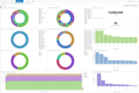






Pluribus Multi-Services Fabric
Data Center Fabric
Multi-site
Data Center
Distributed
Cloud
IoT Video
Security
Network
Segmentation
Network Packet
Broker
Lab Automation
UNUM
Management Platform – Day 0 , 1 & 2
Insight
Analytics
Fabric-wide
VLAN
Fabric-wide
Bridge Domain
Fabric-wide
vNET
Fabric-wide VRFs
Fabric-wide
Policies
Simple, automated Fabric Overlay
Distributed
Fabric Routing
Automated Fabric (VXLAN) Overlay
Fabric-wide end-point and flow visibility
Centralized mgmt. and abstraction of the physical network topology
L2/L3 NOS based on standard, open protocols
Distributed, Controllerless Underlay
Netvisor Network OS

Slide 17
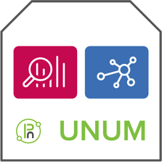






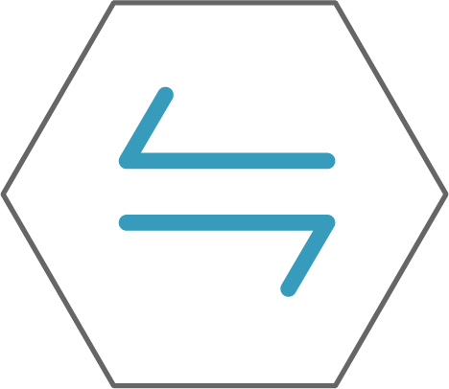









xSP | Smart-City | SLED | Enterprise : Metro Cloud Services
GPON
orchestration
IoT
services
e.g. CCTV recorders |
data lake | controllers
DC
GPON
orchestration
Adaptive
Cloud Fabric
End
customers
any
transport
End
customers
E-TREE
E-LINE or E-LAN
IoT
services
e.g. CCTV recorders |
data lake | controllers
IPv4
Unicast
End
customers
End
customers
L2 VPN
services
GPON
metro
~20km
campus
~2km
Adaptive Cloud
Fabric
isolation
isolation
IoT Endpoints
e.g. IPv6 mobile | CCTV
IoT Endpoints
e.g. IPv6 mobile | CCTV

Slide 18
Success Story: Multi-cloud Interconnect Services
Regional Cloud Service Provider
5 data centers, 4 cities, 2 countries
Multi-site, multi-service, multi-tenant fabric
Fully transparent L1 virtual links,
customer-to-customer and customer-to-cloud
Fabric-level visibility and manageability
Single point of management & monitoring
Per-tenant flow analytics
“I couldn’t believe I could ‘get it all.’ Other solutions had a tenth the bandwidth, no pseudo-wire transparency or were simply limited in scale or multi-tenancy. Plus, I got analytics capabilities as a bonus without any additional equipment needed.”
Network & Security Manager

Slide 19



Private Interconnect – Virtual Link Extension
Virtual Link Extension (vLE) provides transparent point-to-point services emulating direct fiber/cable connectivity
Port link state synchronization between vLE end ports
Carry any protocol/any VLAN
Support client-side LAG
“Virtual Fiber”
Single Fabric
Cluster VTEP
Cluster VTEP
Cluster VTEP
1
2
1
2
1
2

Slide 20

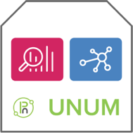




Fabric Distributed Policies (vFlow)
1. vFlow scopes
2. vFlow matching conditions
3. vFlow actions
“Local” or “Fabric”
in-port
out-port
dst-mac
src-ip
dst-ip*
src-port
proto
etc.
none
drop
to-port
to-cpu
copy-to-port
setvlan
set-dmac-to-port
etc.
Steering
Monitoring
Packet Modification
1 Single Fabric
Fabric Policy

Slide 21
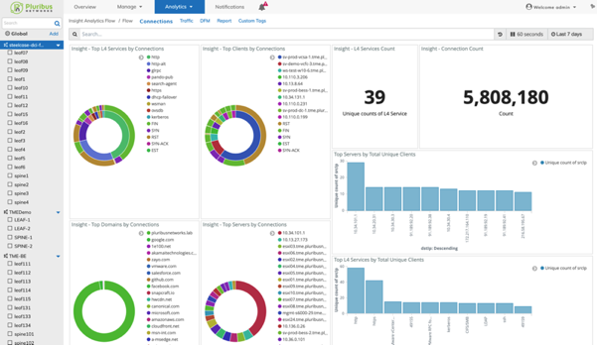
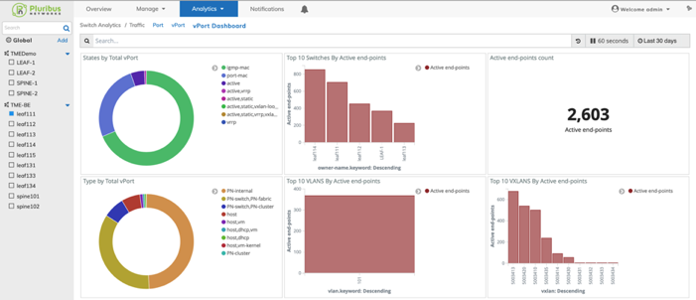





Fabric Integrated Traffic Flow Telemetry
End-point (vPort) based statistics
Flow-based statistics
1 Single Fabric

Slide 22

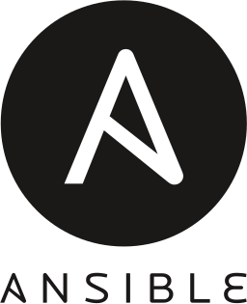
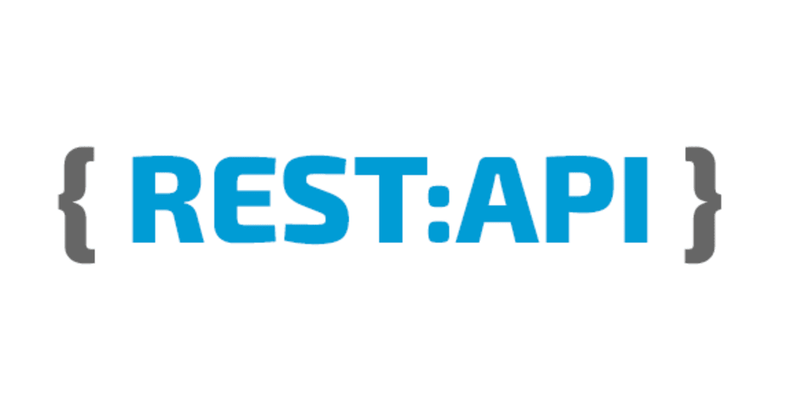

Fabric Programmability: REST API, Python and Ansible available
The REST API, Python scripts or Ansible modules / playbooks can be directed to any of the Fabric nodes and have full visibility / programmability over the whole Fabric
Site VXLAN Tunnels
1 Single Fabric
HW VTEP
HW VTEP
HW VTEP
VTEP
VTEP
VTEP
VTEP
VTEP
VTEP

Slide 23
Links & overige info
Bernard Schep bernard@pluribusnetworks.com https://www.linkedin.com/in/schepbernard/
https://telecominfraproject.com/openran/
https://www.opencompute.org/
https://www.opencompute.org/projects/onie
https://www.opencompute.org/projects/sonic
https://www.nvidia.com/en-us/networking/products/data-processing-unit/
https://www.nvidia.com/en-us/networking/ethernet-switching/spectrum-sn4000/
https://resource.nvidia.com/en-us-linux/cumulus-linux-network-os-datasheet
https://www.broadcom.com/products/ethernet-connectivity/switching/strataxgs/bcm56880-series
https://www.edge-core.com/
https://www.edge-core.com/productsInfo.php?cls=1&cls2=349&cls3=350&id=607
https://azure.github.io/SONiC/
https://agema.deltaww.com/product-info.php?id=84
https://www.celestica.com/landing/networking-storage-and-server-hardware-platform-solutions
https://www.dell.com/en-us/work/shop/povw/networking-z-series
https://www.delltechnologies.com/en-us/networking/index.htm#
https://www.dell.com/learn/us/en/04/product_docs/dell_emc_networking_os10_open_edition_datasheet.pdf
https://www.intel.com/content/www/us/en/newsroom/news/3rd-gen-xeon-scalable-processors.html#gs.0kirnx

Slide 24
Thank You.

